Slide 1
Volunteer Guardianship by Ryan Wolfe

Slide 2
How the volunteer guardianship program began at First Christian

Slide 3
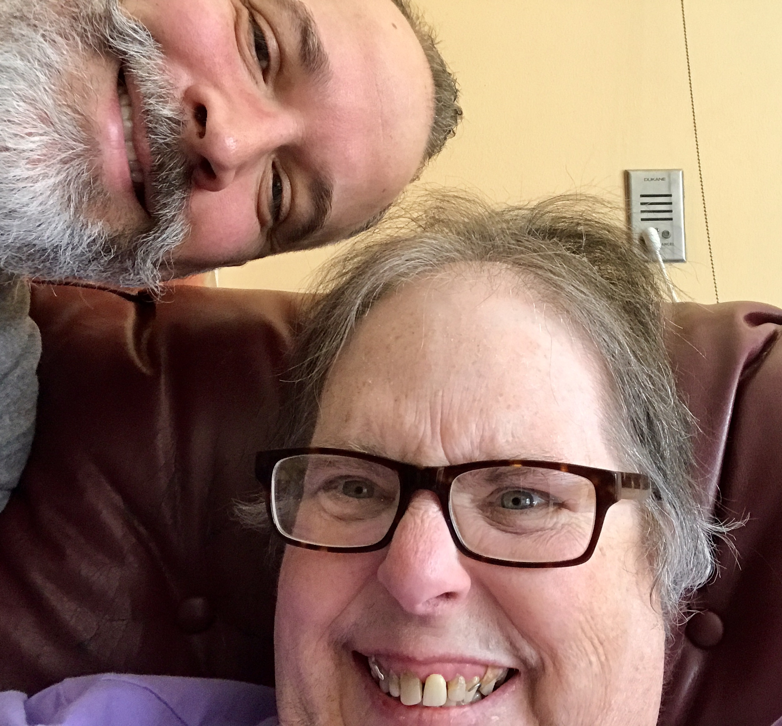

Slide 4
Philosophy
A healthy Disability Ministry knows the needs of its disability community and meets them

Slide 5
How can we be a blessing no strings attached?

Slide 7
How can we be a blessing no strings attached?

Slide 8
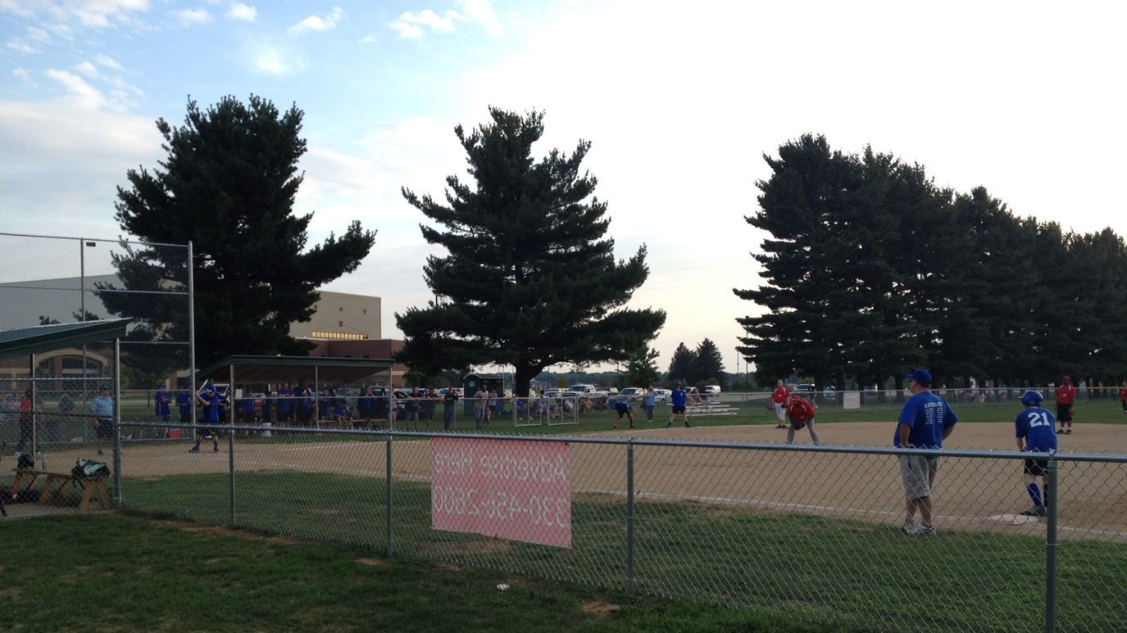

Slide 9
How can we be a blessing no strings attached?

Slide 10
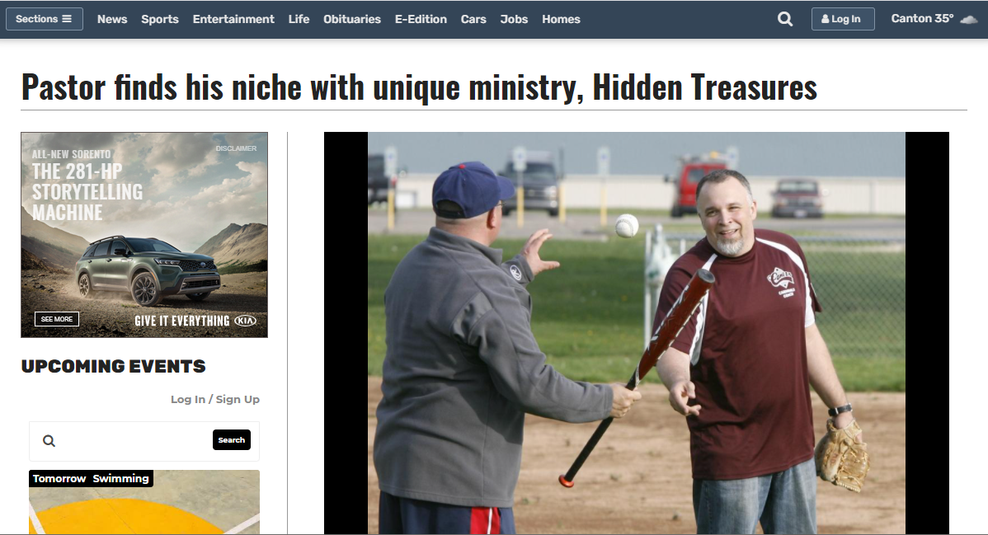

Slide 11
Volunteer Guardians

Slide 12
What is a guardian?
A guardian is any adult person, association, or corporation appointed by the Probate Court to assume responsibility for the care and management of the person, the estate, or both, of an incompetent person or minor child.

Slide 13
Why guardianship?
People affected by disability are abused and neglected at a higher rate than any other people group in the world.

Slide 14
Proverbs 31:8
Speak up for those who cannot speak for themselves;
ensure justice for those being crushed.

Slide 15
Types of Guardianship
Person: Controls and protects the person
Estate: Controls and protects the assets or the property of the ward
Both

Slide 16
Steps in becoming a Guardian
File out an application with Probate Court
Prospective ward, next of kin notified of guardianship hearing date
Interviews conducted
Formal hearing conducted

Slide 17
Duties of a Guardian
Visit ward once a month
Monitor basic needs, safety, and health concerns
Become the “go to” person for living facility
Advocate
Be a friend

Slide 18
Process
Contact County Probate Court
Contact County Board of Developmental Disabilities
Search for local guardianship agencies
Educate congregation
Recruit volunteers

Slide 19
Partnership
Probate Court
County Board of DD
Church
Guardian Support Services

Slide 20
Do we have to go through the courts?

Slide 21
What If…
Everyone had someone

Slide 22
Galatians 6:10
When we have the opportunity to do good to anyone, we should do it. But we should give special attention to those who are in the family of believers.

Slide 23
Philosophy
It is best practice in Disability Ministry to always start with who you have

Slide 24
Create a profile
Name: Coral
Age: 73
Enjoys: Cross stitching, reading her bible, volunteering at church, talking on the phone with friends
Favorite Color: Coral
Favorite Food: Tootsie Pops
Favorite TV Show: Walker Texas Ranger, Cop Shows, Religious TV

Slide 25
Everyone Needs Someone

Slide 26
Volunteer Guardianship by Ryan Wolfe

